Slide 1
Glocal Co-operative Bank Business Requirement Plan
Requirement Plan will help the GCo. Bank to establish In-house Net Banking Infrastructure

Slide 2

Business Requirements
Being a small co-operative bank, GCB (Glocal Co-operative Bank) doesn’t own state-of-the-art banking infrastructure at the moment.
As a part of the infrastructure & service enhancement and long-term cost optimization, GCB plans to develop in-house infrastructure for some of the services currently outsourced.
The first step in this direction is to build in-house capacity to fulfil IMPS transactions.

Slide 3


Content
Portfolio Overview
High-level functional Requirement
In-scope Requirements
Out-of Scope Requirements
User Story and Backlog creations
Process Diagram
UI Design
Prototype

Slide 4




Portfolio Overview
What’s the Issue - The GCB doesn't have their own state-of-the-art infrastructure so they have to rely on other big shot banks for the net banking payment transfer.
Who it’s affecting- GCB rely on other banks for fund transfer which is affecting both the parties bank and its customer because its increase their payment schedule time.
Who are the stakeholders- Bank, GCB’s IT Dept. and Customers
Solution- The Bank have its own in-house infrastructures of net banking. Although, some of the major services along with foreign outward remittance will be outsourced. However, the initial service for the payment transfer will be IMPS transactions.

Slide 5
High-Level Functional Requirements
The net-banking customer should be able to add a beneficiary/payee and place IMPS request for registered beneficiaries
The Bank’s IT system should be able to liaise with
NPCI system and submit to NPIC the outgoing IMPS
request.
Priority Level- High
Product Delivery- Phase-1

Slide 6
High-Level Functional Requirements
3. The bank’s IT system should be able to receive the confirmation from NPCI.
4. The Bank’s IT system should be able to liaise with
NPCI system and submit to NPIC the outgoing IMPS
request.
Priority Level- High
Product Delivery- Phase-1

Slide 7
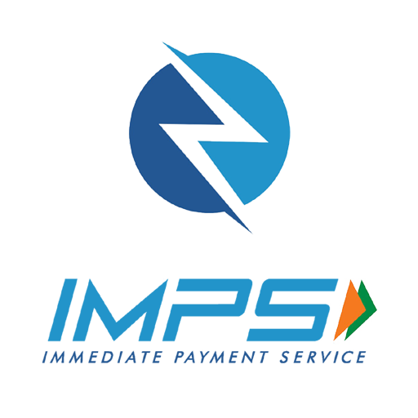
Immediate Payment Service (IMPS) is a mode of money transfer from one bank account to
another in the Indian banking system. The system enabled 24x7x365 real-time, interbank,
electronic money transfers when there was only NEFT and RTGS facilities available in India.

Slide 8
Out of Scope
NEFT Transaction Other than IMPS transactions customer can opt NEFT payment transactions.
RTGS Transaction Remitter can opt RTGS as an alternate payment option than the IMPS and NEFT.

Slide 9
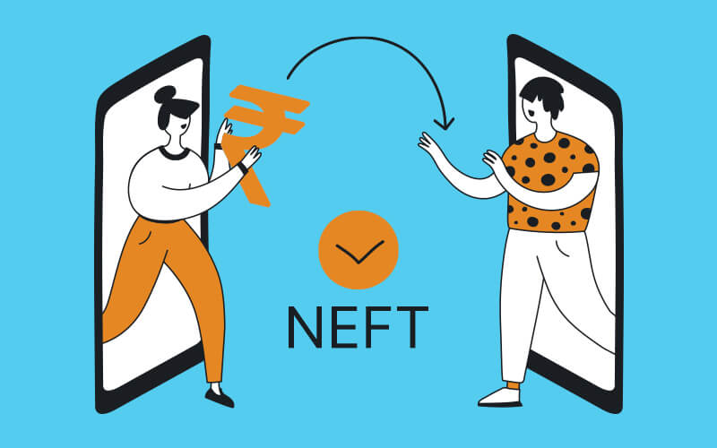
NEFT
It’s an electronic payment transfer mode, RBI (Reserve Bank of India) is the transaction authority of the mode. The minimum transfer value is Rs 1 till no maximum limit. It takes 30 mins to settle the transfer.

Slide 10
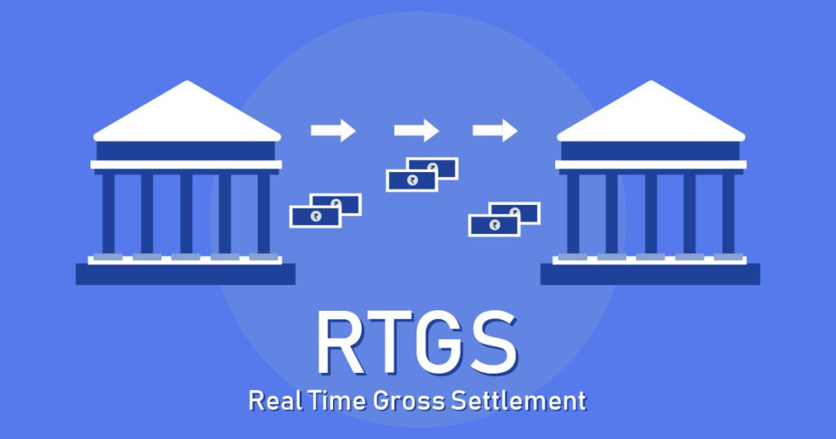
RTGS
RTGS (Real-Time Gross Settlement) is an electronic fund transfer system all the RTGS transactions is settle by RBI. The minimum limit of the mode is Rs 200 K and the their is no maximum limit. All the transfers are settled in real-time.

Slide 11
User Story and Backlog
Click- https://mythjosh4774.atlassian.net/jira/software/projects/FT/boards/3/backlog?epics=visible
Note
The following link will redirect the user to Atlassian Jira Software. The User can check the user story and backlog.

Slide 12
Process Diagram
Click URL-
https://app.diagrams.net/#LGCB%20.drawio
Note
The following link will redirect the user to Draw.io UML Software. The User can view the UML and Sequence Diagram their.

Slide 13
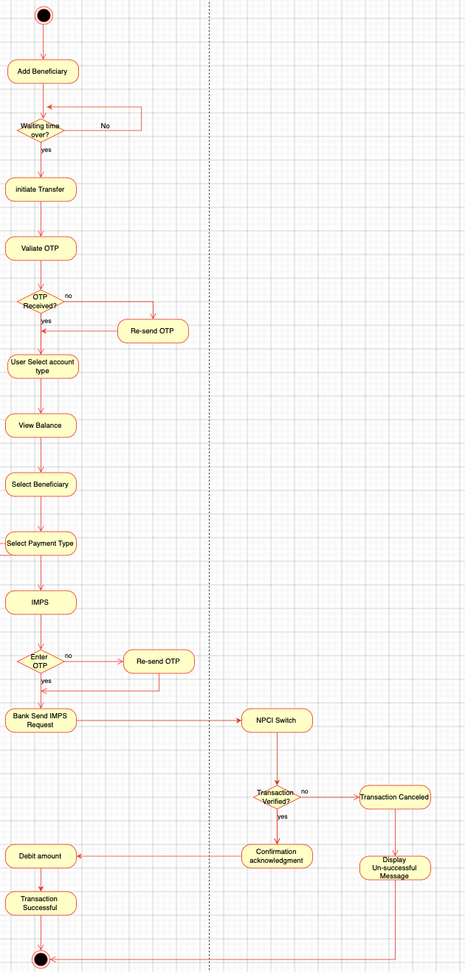
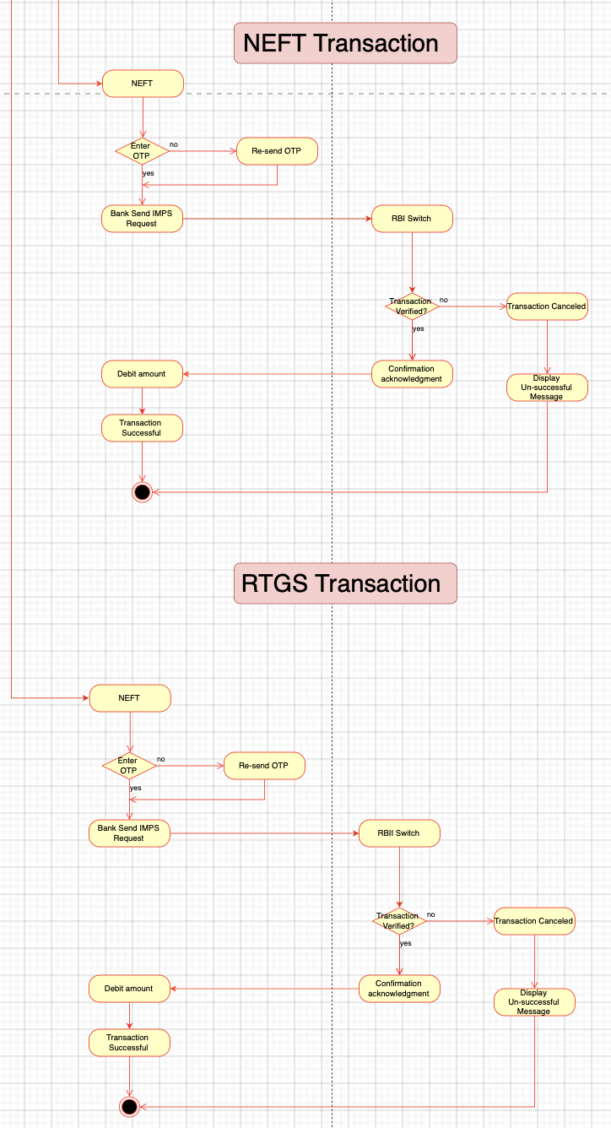
Process Diagram

Slide 14
UI Design
Click URL
https://www.figma.com/file/misKhmYTwqLUkLqWvObhMd/Pay---Digital-Banking-Landing-Page-Website-(Community)?type=design&node-id=0-1&mode=design&t=QcY2bxk1at1S31US-0
Note
The following link will redirect the user to Figma UI Tool. The User can check the high-level UI design

Slide 15

Prototype

Slide 16
Fin

